Slide 1


London, ….
Search
Street Crime
Before & During the Covid-19 Pandemic
Pallavi Atkarne
Iwona Izdebska
Diana Mutheu
Cherry O’Connell
Lina Ziaka

Slide 2
Our Questions
1
2
3
Does the Covid-19 Pandemic have an effect on street crime levels?
What are the top street crimes, crime locations and crime outcomes before and during the Pandemic?
Can Machine Learning predict street crimes and give us insights about the data?

Slide 3
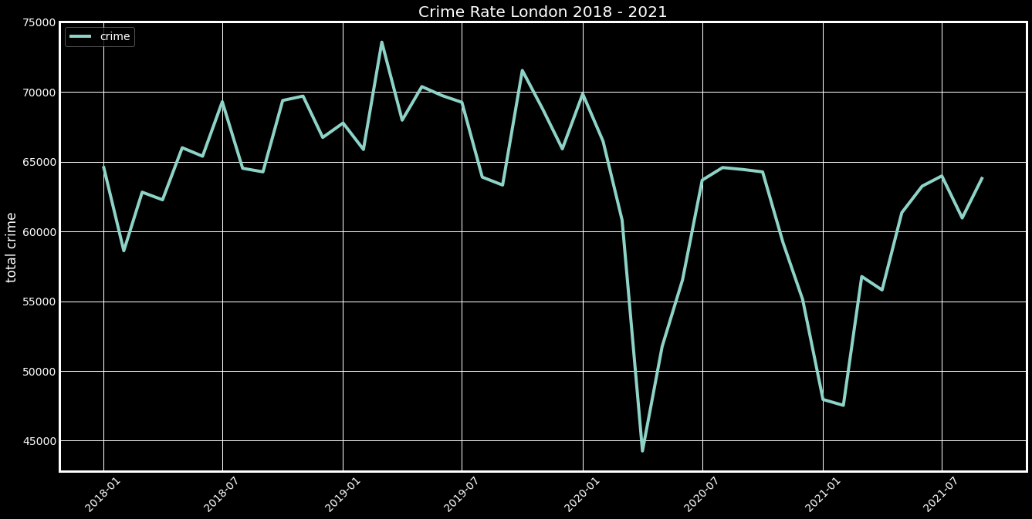
London
Notes:
London crime data are from Metropolitan Police (also called The Met or Scotland Yard) and City of London Police.

Slide 4
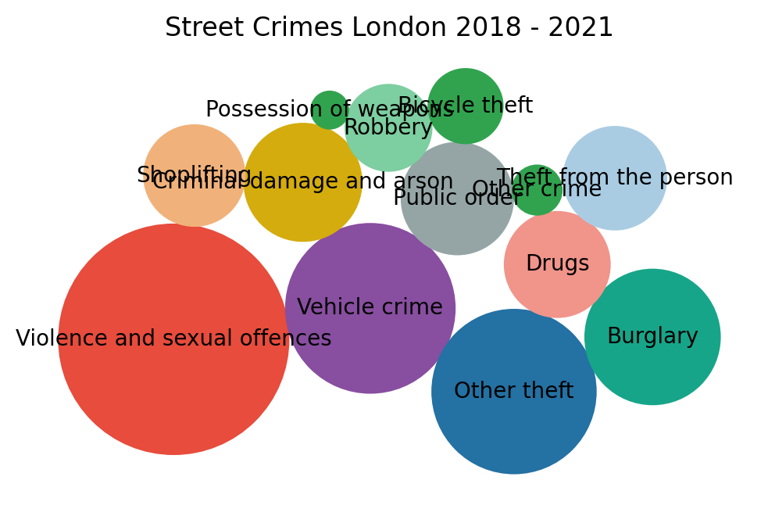
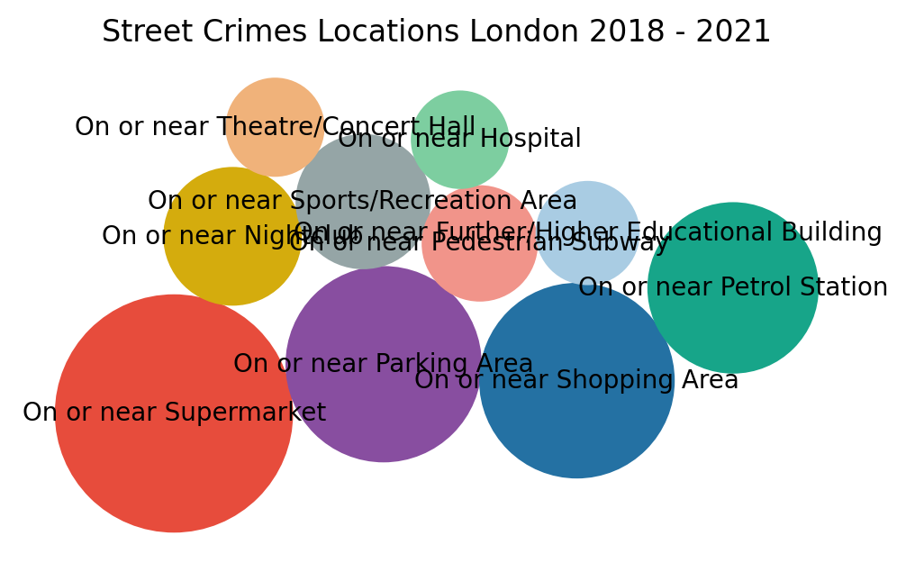

London
Total: 2.8M+
Violence & Sexual Offences are 700K+
About 110K+ crimes were reported on or near supermarkets
Notes:
London crime data are from Metropolitan Police (also called The Met or Scotland Yard) and City of London Police.

Slide 5
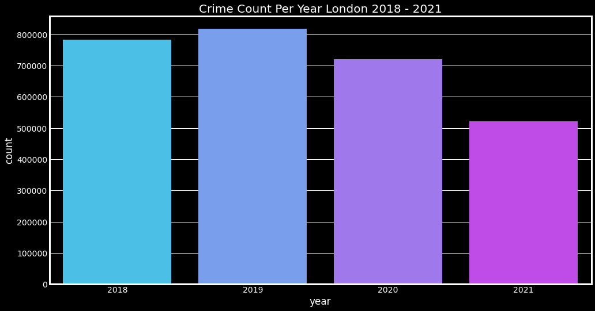
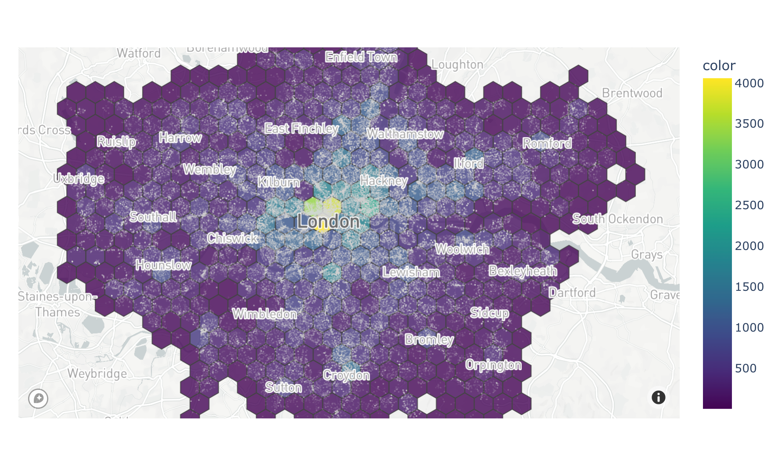
London
Notes:
London crime data are from Metropolitan Police (also called The Met or Scotland Yard) and City of London Police.

Slide 6
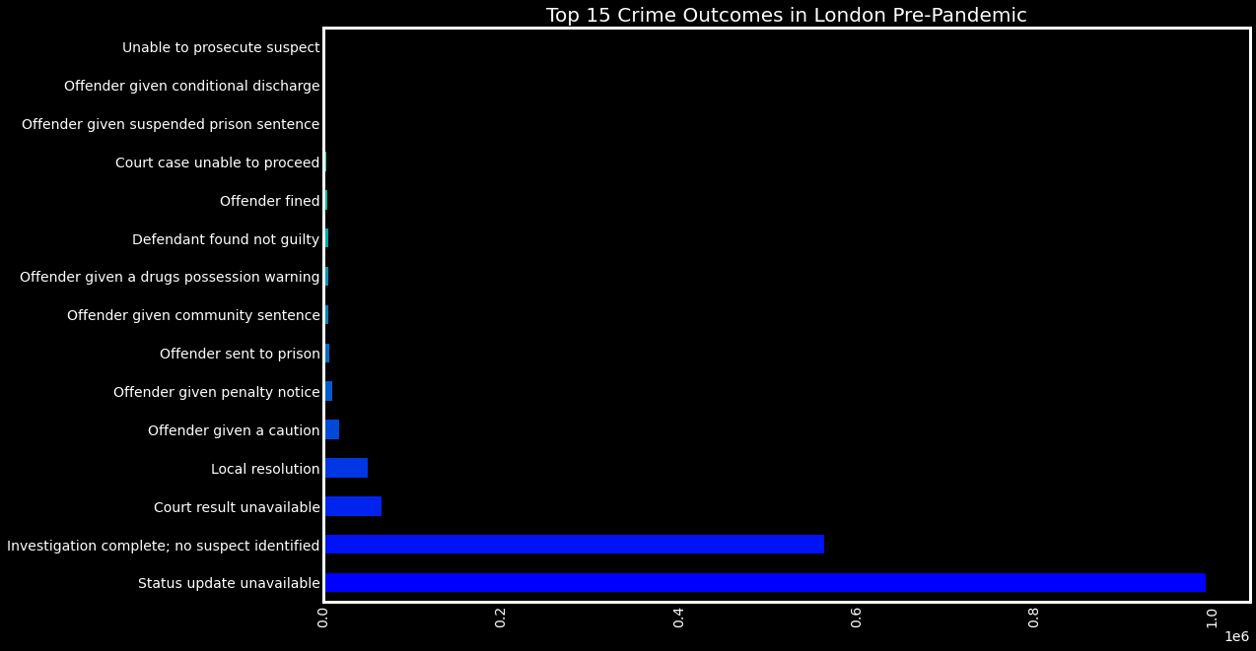
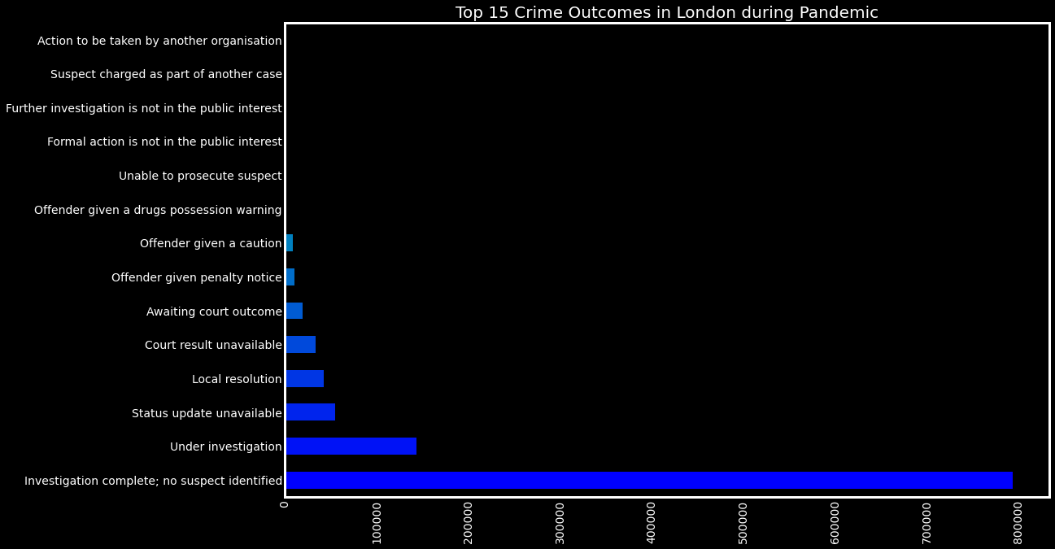
Crime outcomes for London

Slide 7

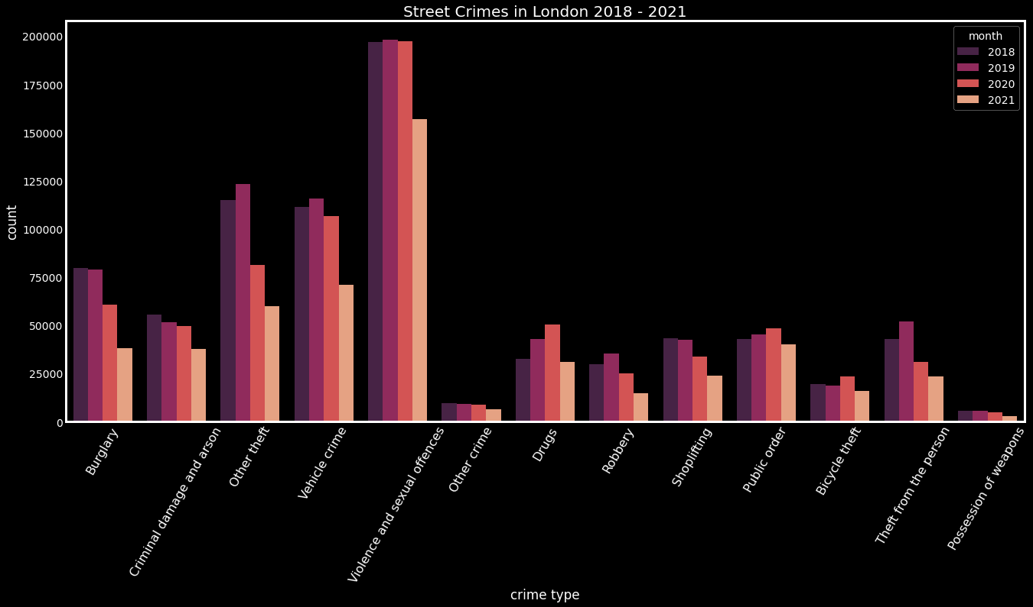
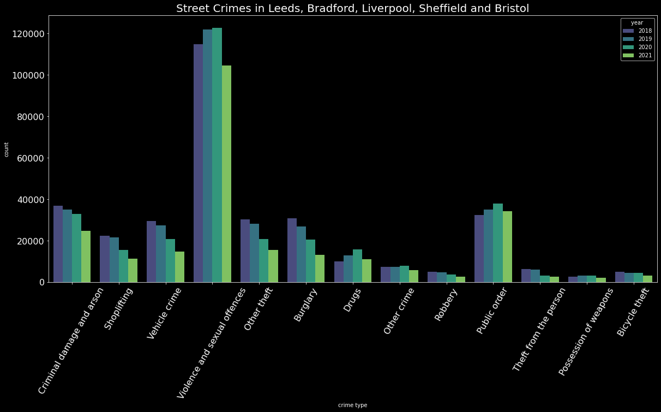
2018 - 2021
Street Crime Count

Slide 8
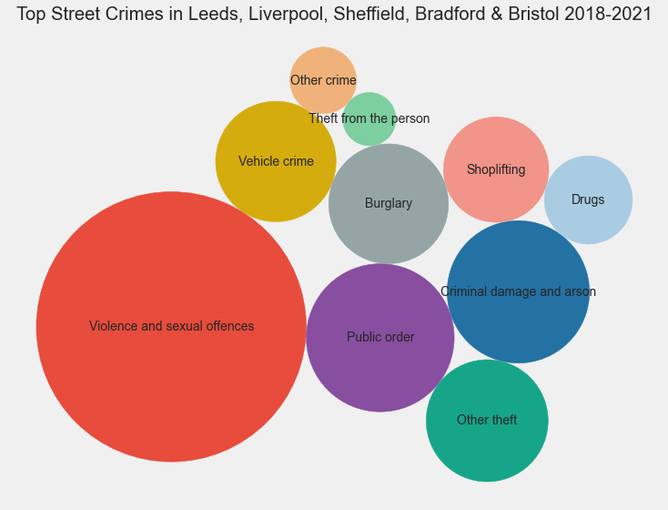
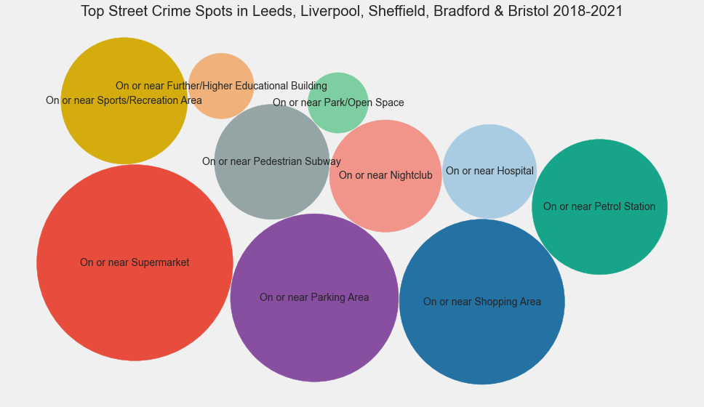

Other Cities
Total: 1.2M+
Violence & Sexual Offences are 400K+
About 35K+ crimes were reported on or near supermarkets

Slide 9

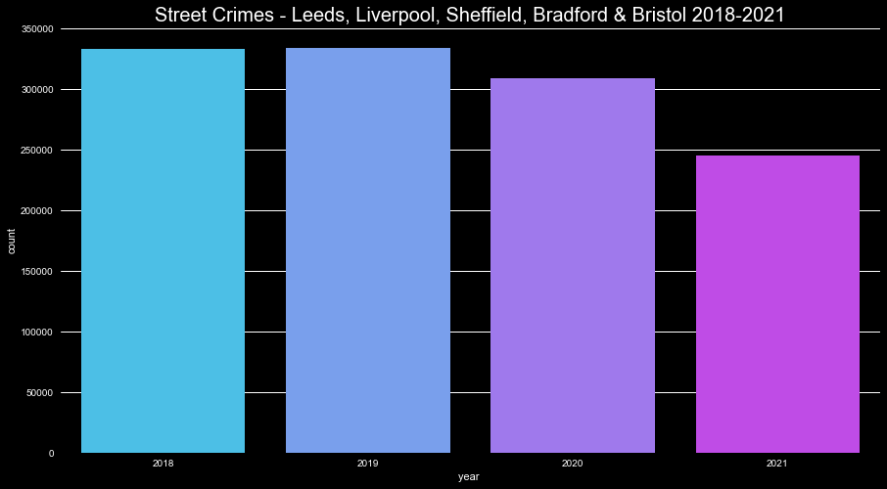
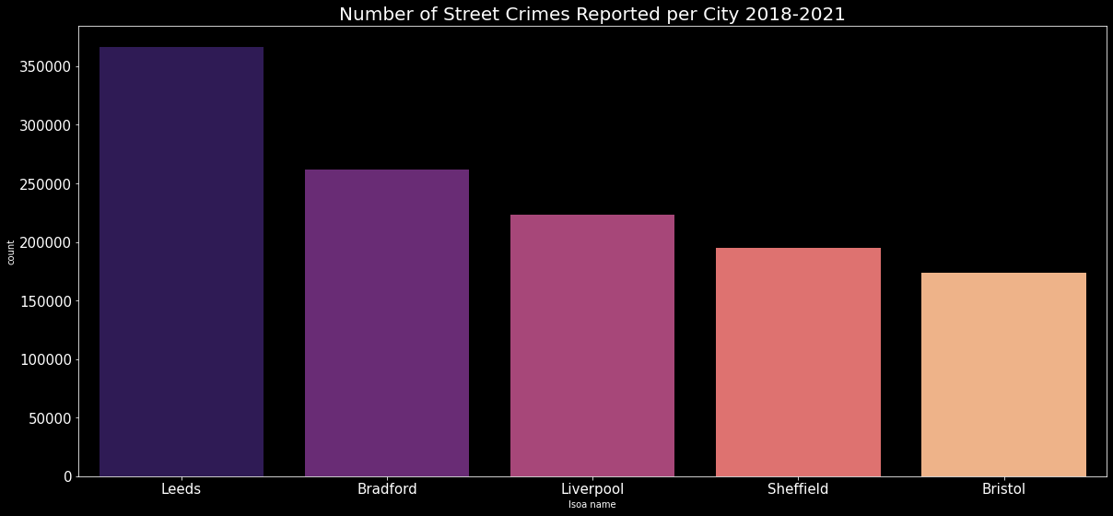
Leeds, Liverpool, Sheffield, Bradford and Bristol 2018-2021
Notes:
London crime data are from Metropolitan Police (also called The Met or Scotland Yard) and City of London Police.

Slide 10
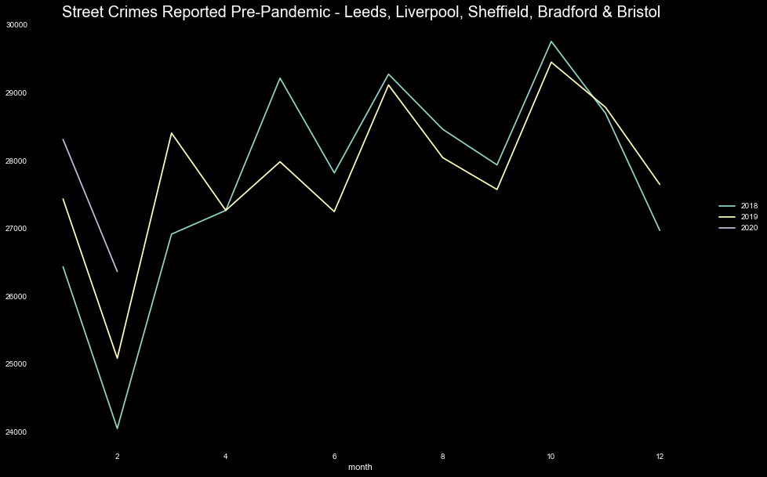
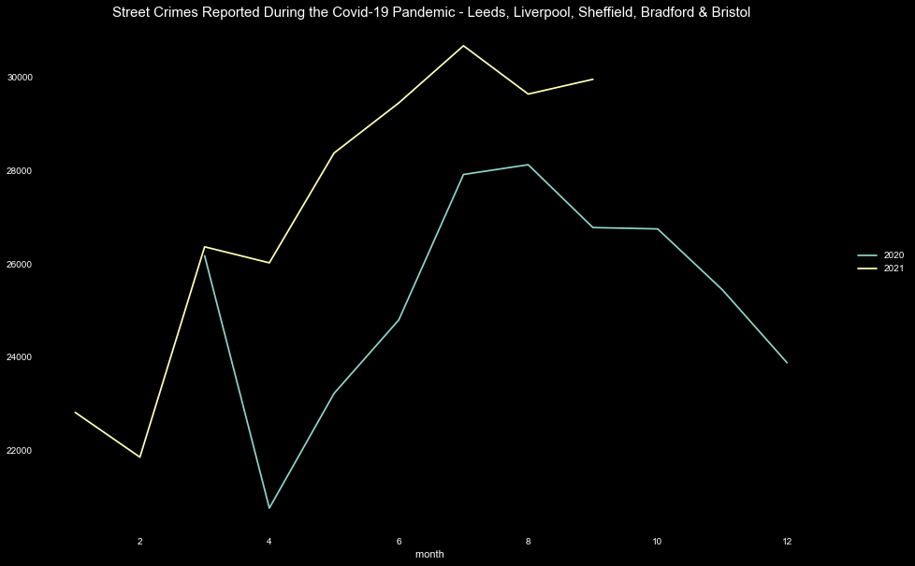

Street Crimes Reported in Leeds, Liverpool, Sheffield, Bradford and Bristol Before and During Covid-19 Pandemic

Slide 11
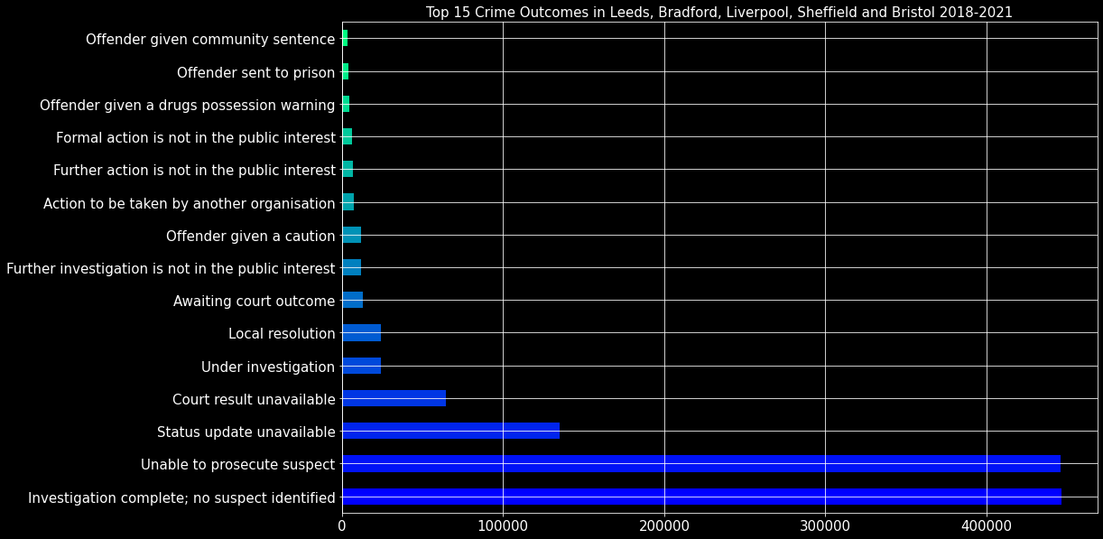
Crime outcomes for other cities

Slide 12

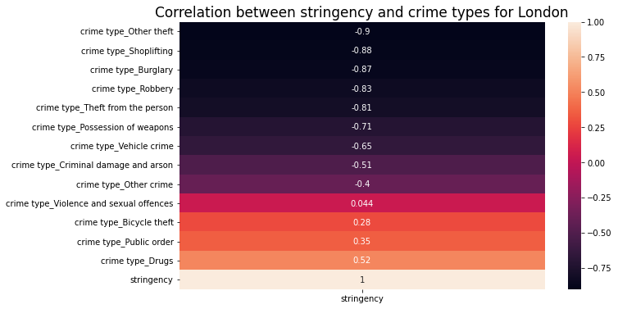
Correlation analysis for London
Correlation between theft, burglary, robbery, shoplifting and stringency of Covid-19 measures ranged between -0.81 and - 0.9
Correlation between drug misuse and stringency was 0.52 meaning that drug use increased.
Name
Point 2

Slide 13
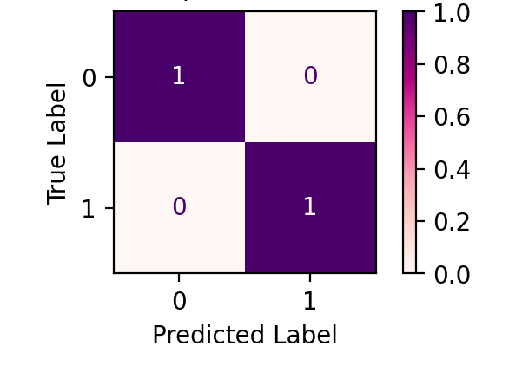
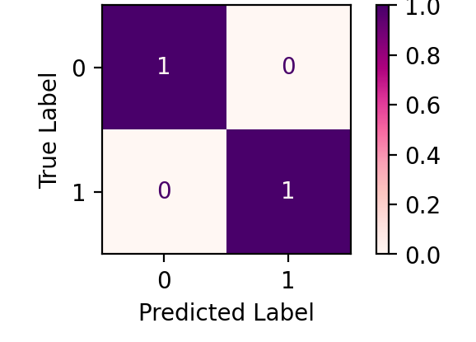
ML attempts
1
2
3
4
Multiple Regression
RF and KNN regression
RF and KNN classification
Unsupervised clustering
Regression predicting stringency from crime types counts by month
Results:
The R2 for the model is 0.87
Regression with crime count as the target variable in order to predict future crime
Results:
For both models the R2 score was 1
Classification with covid as the target variable. For our data classification is more fitting than regression
Results:
For both models accuracy
Precision and recall were 100%
Clustering using K-means to see whether crimes are split in different clusters before and during COVID
Results:
1 cluster formed before COVID and 2 after COVID

Slide 14
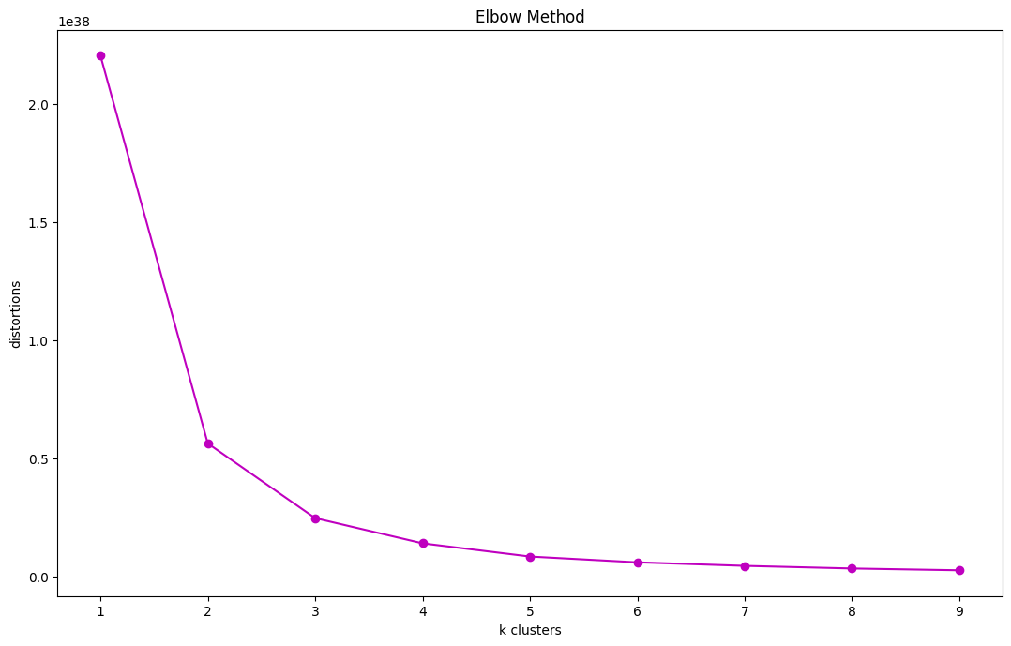
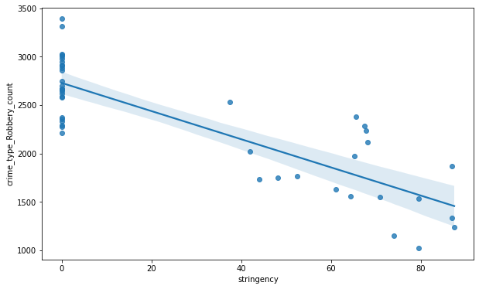
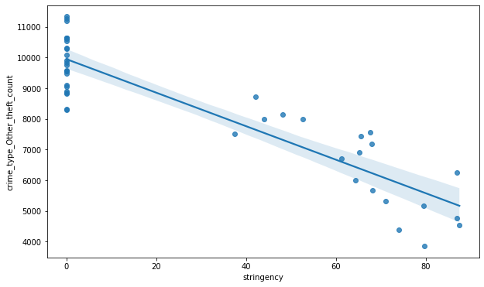
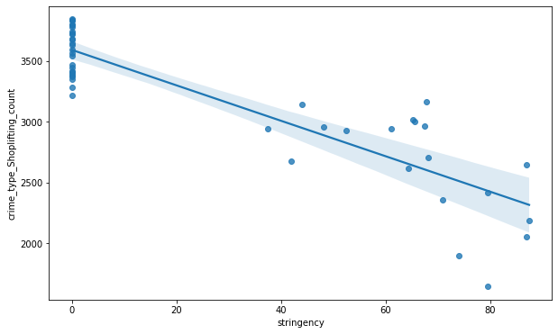
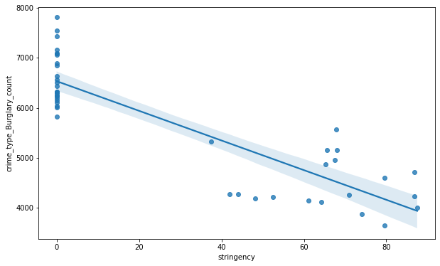
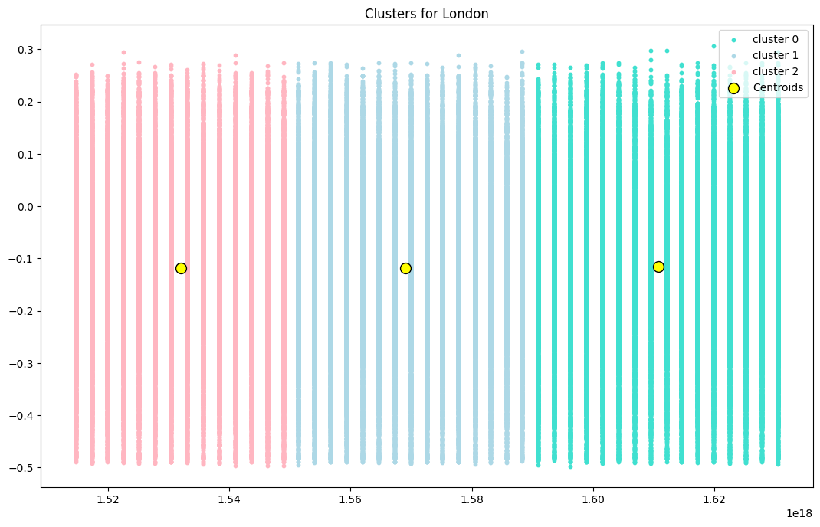
Regression
Clustering

Slide 15
Project steps
5
ML
4
Correlations
Performed regression, classification and unsupervised clustering. Clustering showed a clear difference between before and during the COVID-19 Pandemic with different clusters.
3
Exploratory Data Analysis
2
Correlation between crime types and stringency: showed that crime types are affected by stringency
1
Data preprocessing
Plots of outcomes, locations, cime types to get insights on the data and the underlying characteristics.
Data gathering
Removed missing values, irrelevant columns, added columns, one hot encoded data.
Explored research ideas and topics. Gathered data from the UK police database.

Slide 16



Conclusion
Data belonged in different clusters before and during COVID-19
Street Crimes decreased during the pandemic with the exception of ...
COVID-19 and stringency had an effect on crime rates
London: Drugs, Public Order and Bicycle Theft
Other Cities: Violence and sexual offences, Dugs, Other Crime, and Public Order
London: Theft, Robbery, Burglary, Shoplifting, Vehicle crime show high negative correlation with stringency and Covid-19
Clustering shows that data formed 3 different clusters before and during the
pandemic. 2 clusters belonged to the pre-pandemic period while the other one during COVID. That indicates that there was a difference in the underlying data patterns before and after COVID.

Slide 17
















Tools, libraries, and resources

Slide 18

Thank you! Stay safe.

